Slide 1
Issues or traits?
Understanding Americans partisan favorability and animosity through open-ended questions
01 May 2026
David Wei Wang, Rehan Mirza, Ying Zhang

Slide 2

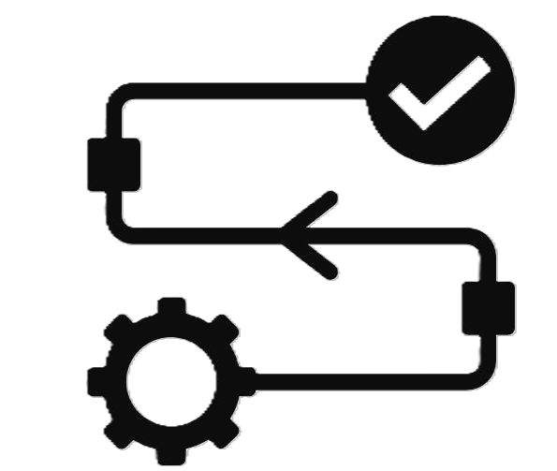

Agenda
RESEARCH QUESTIONS AND DATA
How can we predict partisan animosity and favorability?
ANES (American National Election Studies) dataset
METHODS
Study 1: Text mining analysis to predict partisan favorability and animosity
Study 2: Who responds to open-ended questions on the parties?
RESULTS
Exploratory Data Analysis
Study 1: Text mining analysis to predict partisan favorability and animosity
Study 2: Who responds to open-ended questions on the parties?

Slide 3
Background and Research Question(s)
Background
Partisan animosity and polarization and grown over the past 20 years
Debate over the specific reasons for affective polarization:
Intergroup conflict (identity and affect)
Ideological sorting (widening policy gaps)
We use survey data from the American National Elections Study (ANES) to examine what Americans provide as their reasons for in-group favorability and out-group animosity
RQ1: What reasons do American’s provide in open-ended responses for liking their in-group party, and disliking the out-group party?
RQ2: Which respondent attributes predict whether someone provides open-ended responses about the parties?

Slide 4
Agenda
RESEARCH QUESTIONS AND DATA
How can we predict partisan animosity and favorability?
ANES (American National Election Studies) dataset
METHODS
Study 1: Text mining analysis to predict partisan favorability and animosity
Study 2: Who responds to open-ended questions on the parties?
RESULTS
Exploratory Data Analysis
Study 1: Text mining analysis to predict partisan favorability and animosity
Study 2: Who responds to open-ended questions on the parties?

Slide 5
ANES dataset
Source & Coverage
ANES Time Series, 2008-2024 (5 election cycles)
Final sample: 26,307 responses
Key variables
Outcome (Study 1): Feeling thermometers for Democrats and Republicans (0-100 scale), recoded into 5-class indicator)
Text predictors: Free text-responses to express favorability or animosity towards parties
Outcome (Study 2): Whether respondent provided open-ended text response, coded as binary
~40-60% of respondents did not provide open-ended text responses
Controls: Survey year, forced in as fixed effects for all models
Demographics and other participant characteristics available as predictors in Study 2 (e.g., ideology, age, gender, race/ethnicity, education)
CSES liking scale as an alternative outcome measure to thermometers (robustness check)

Slide 6
Agenda
RESEARCH QUESTIONS AND DATA
How can we predict partisan animosity and favorability?
ANES (American National Election Studies) dataset
METHODS
Study 1: Text mining analysis to predict partisan favorability and animosity
Study 2: Who responds to open-ended questions on the parties?
RESULTS
Exploratory Data Analysis
Study 1: Text mining analysis to predict partisan favorability and animosity
Study 2: Who responds to open-ended questions on the parties?

Slide 7
Study 1: Text Mining Approach
Study Design
Feeling thermometers were recoded into a 5-class scale: “highly unfavorable” (0–19), “unfavorable” (20–39), “neutral” (40–59), “favorable” (60–79), “highly favorable” (80–100)
Clustering at the tails (0-19 and 80-100) motivates a more granular scale
Separate models for Democrat and Republican thermometers
Three text mining methods: stemming, n-grams, skip-grams with consistent results across them
Skip-grams selected as primary method due to better sentiment handling (negation, within-sentence connections), and robustness to conversational language
Multinomial LASSO with year fixed effects used for variable selection (~100-150 terms per model) followed by Relaxed LASSO (GLM) on LASSO-selected terms
Robustness checks
Partisan stratification: Analyses conducted on full sample, though partisan stratification (only Republicans rating Democrats, only Democrats rating Republicans) provided consistent results
CSES party liking scale: Top predictors provided substantively consistent results with thermometer models

Slide 8
Agenda
RESEARCH QUESTIONS AND DATA
How can we predict partisan animosity and favorability?
ANES (American National Election Studies) dataset
METHODS
Study 1: Text mining analysis to predict partisan favorability and animosity
Study 2: Who responds to open-ended questions on the parties?
RESULTS
Exploratory Data Analysis
Study 1: Text mining analysis to predict partisan favorability and animosity
Study 2: Who responds to open-ended questions on the parties?

Slide 9
Study 2: Open-ended Response Predictors Approach
Study Design
Whether a respondent provided open-ended text, coded a binary (1 = provided text, 0 = did not respond or provided no usable text)
Four separate outcomes: Democrat likes, Democrat dislikes, Republican likes, Republican dislikes
Candidate Predictors: Demographics and participant characteristics (party ID, ideology, age, gender, race/ethnicity, education, region, thermometer ratings)
Dropped collinear predictors (e.g., age cohort) and items not asked every survey year
Binomial LASSO with year fixed effects used for variable selection, followed by Relaxed LASSO (GLM) with year-clustered errors on LASSO-selected terms
Key motivation: Understand whether ~40-60% non-response rate is non-random; who responds will inform selection bias for Study 1
Robustness check
Pooled outcome: Single binary outcome (provided text of any of the four items) results in consistent predictors to main study, supporting that results are not item-specific noise

Slide 10
Agenda
RESEARCH QUESTIONS AND DATA
How can we predict partisan animosity and favorability?
ANES (American National Election Studies) dataset
METHODS
Study 1: Text mining analysis to predict partisan favorability and animosity
Study 2: Who responds to open-ended questions on the parties?
RESULTS
Exploratory Data Analysis
Study 1: Text mining analysis to predict partisan favorability and animosity
Study 2: Who responds to open-ended questions on the parties?

Slide 11
Exploratory Data Analysis
Update once data is received from David

Slide 12
Agenda
RESEARCH QUESTIONS AND DATA
How can we predict partisan animosity and favorability?
ANES (American National Election Studies) dataset
METHODS
Study 1: Text mining analysis to predict partisan favorability and animosity
Study 2: Who responds to open-ended questions on the parties?
RESULTS
Exploratory Data Analysis
Study 1: Text mining analysis to predict partisan favorability and animosity
Study 2: Who responds to open-ended questions on the parties?

Slide 13
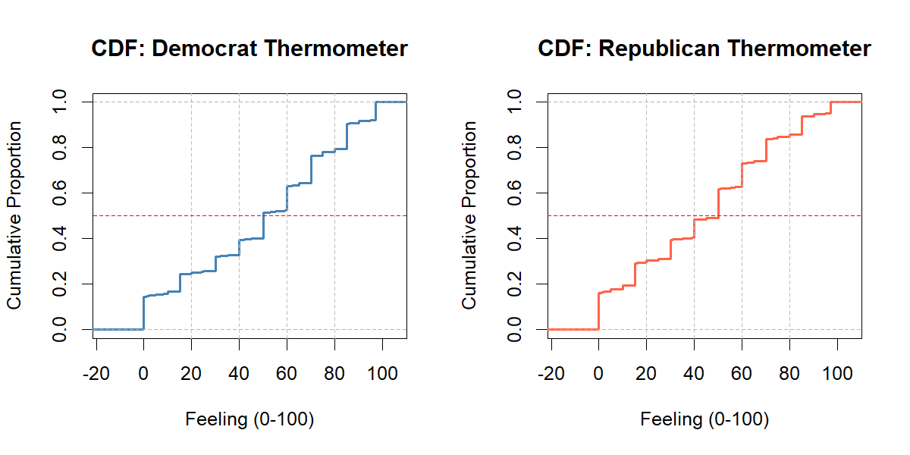
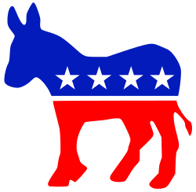
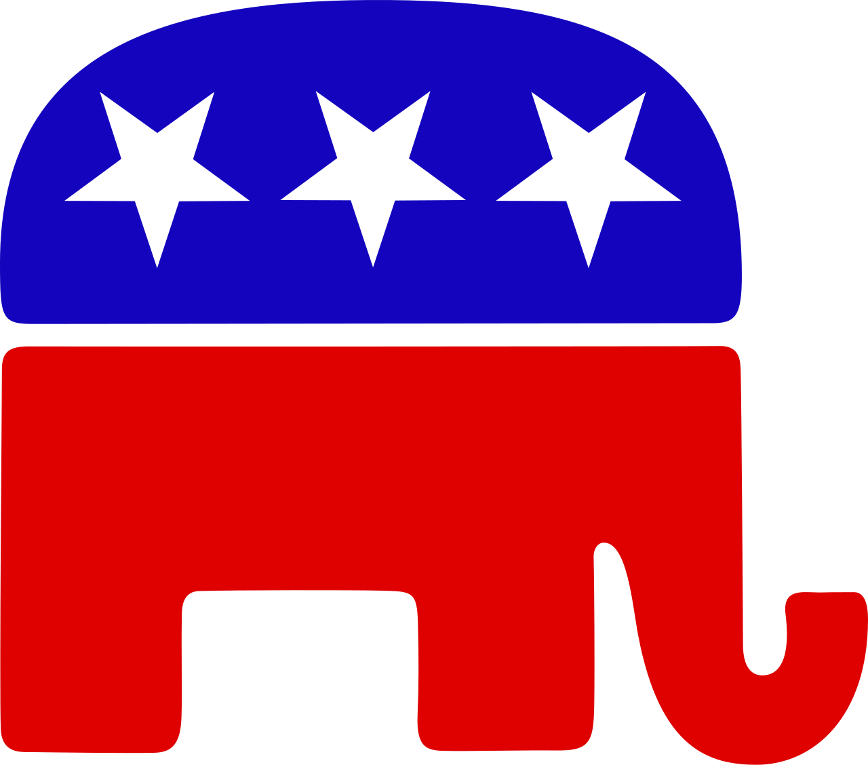
Partisan sentiment is polarized, with a notable cluster at peak animosity (thermometer = 0)

Slide 14
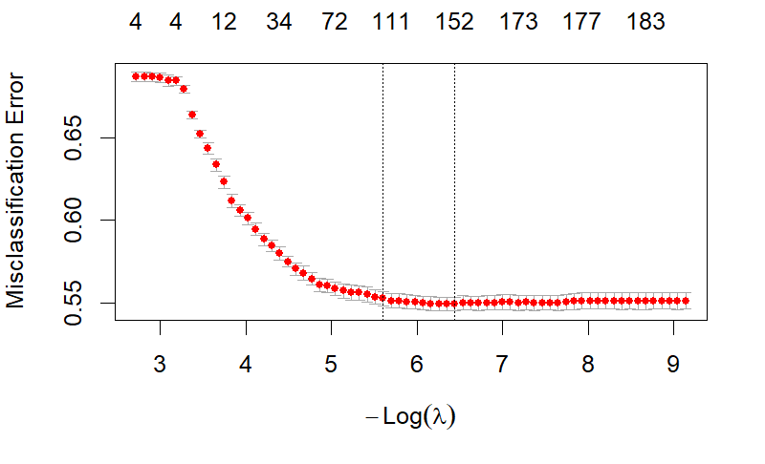
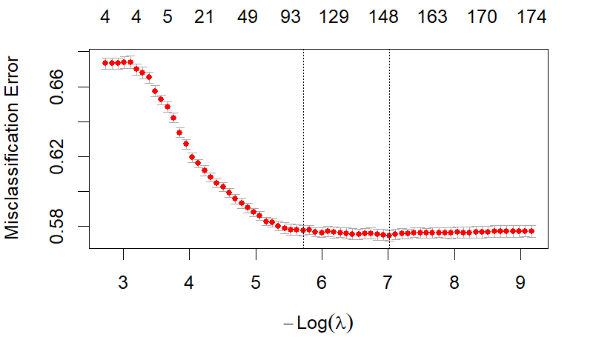
LASSO selects ~100-150 informative terms per model
LASSO Cross-validation Plot
(Democrat thermometer, skip-grams model)
LASSO Cross-validation Plot
(Republican thermometer, skip-grams model)
Use λ.1se-selected terms for relaxed LASSO

Slide 15
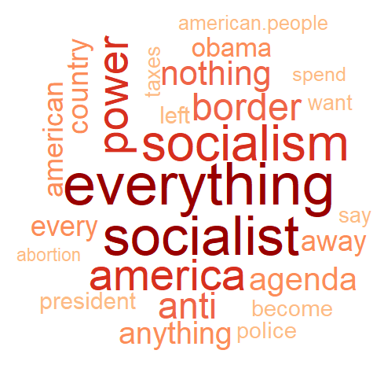
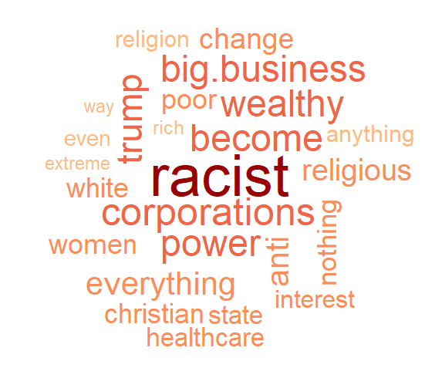
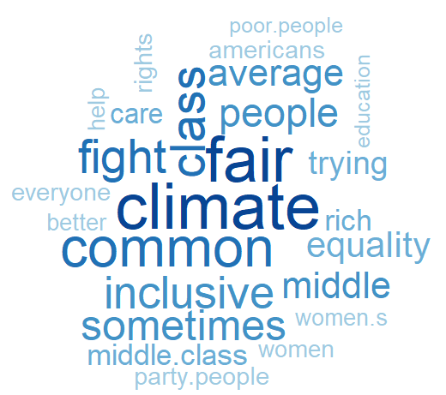

Partisan animosity is more trait/affect-driven for the Republican party, and more policy-driven for Democrats
Democrat animosity
Republican animosity
Democrat favorability
Republican favorability

Slide 16
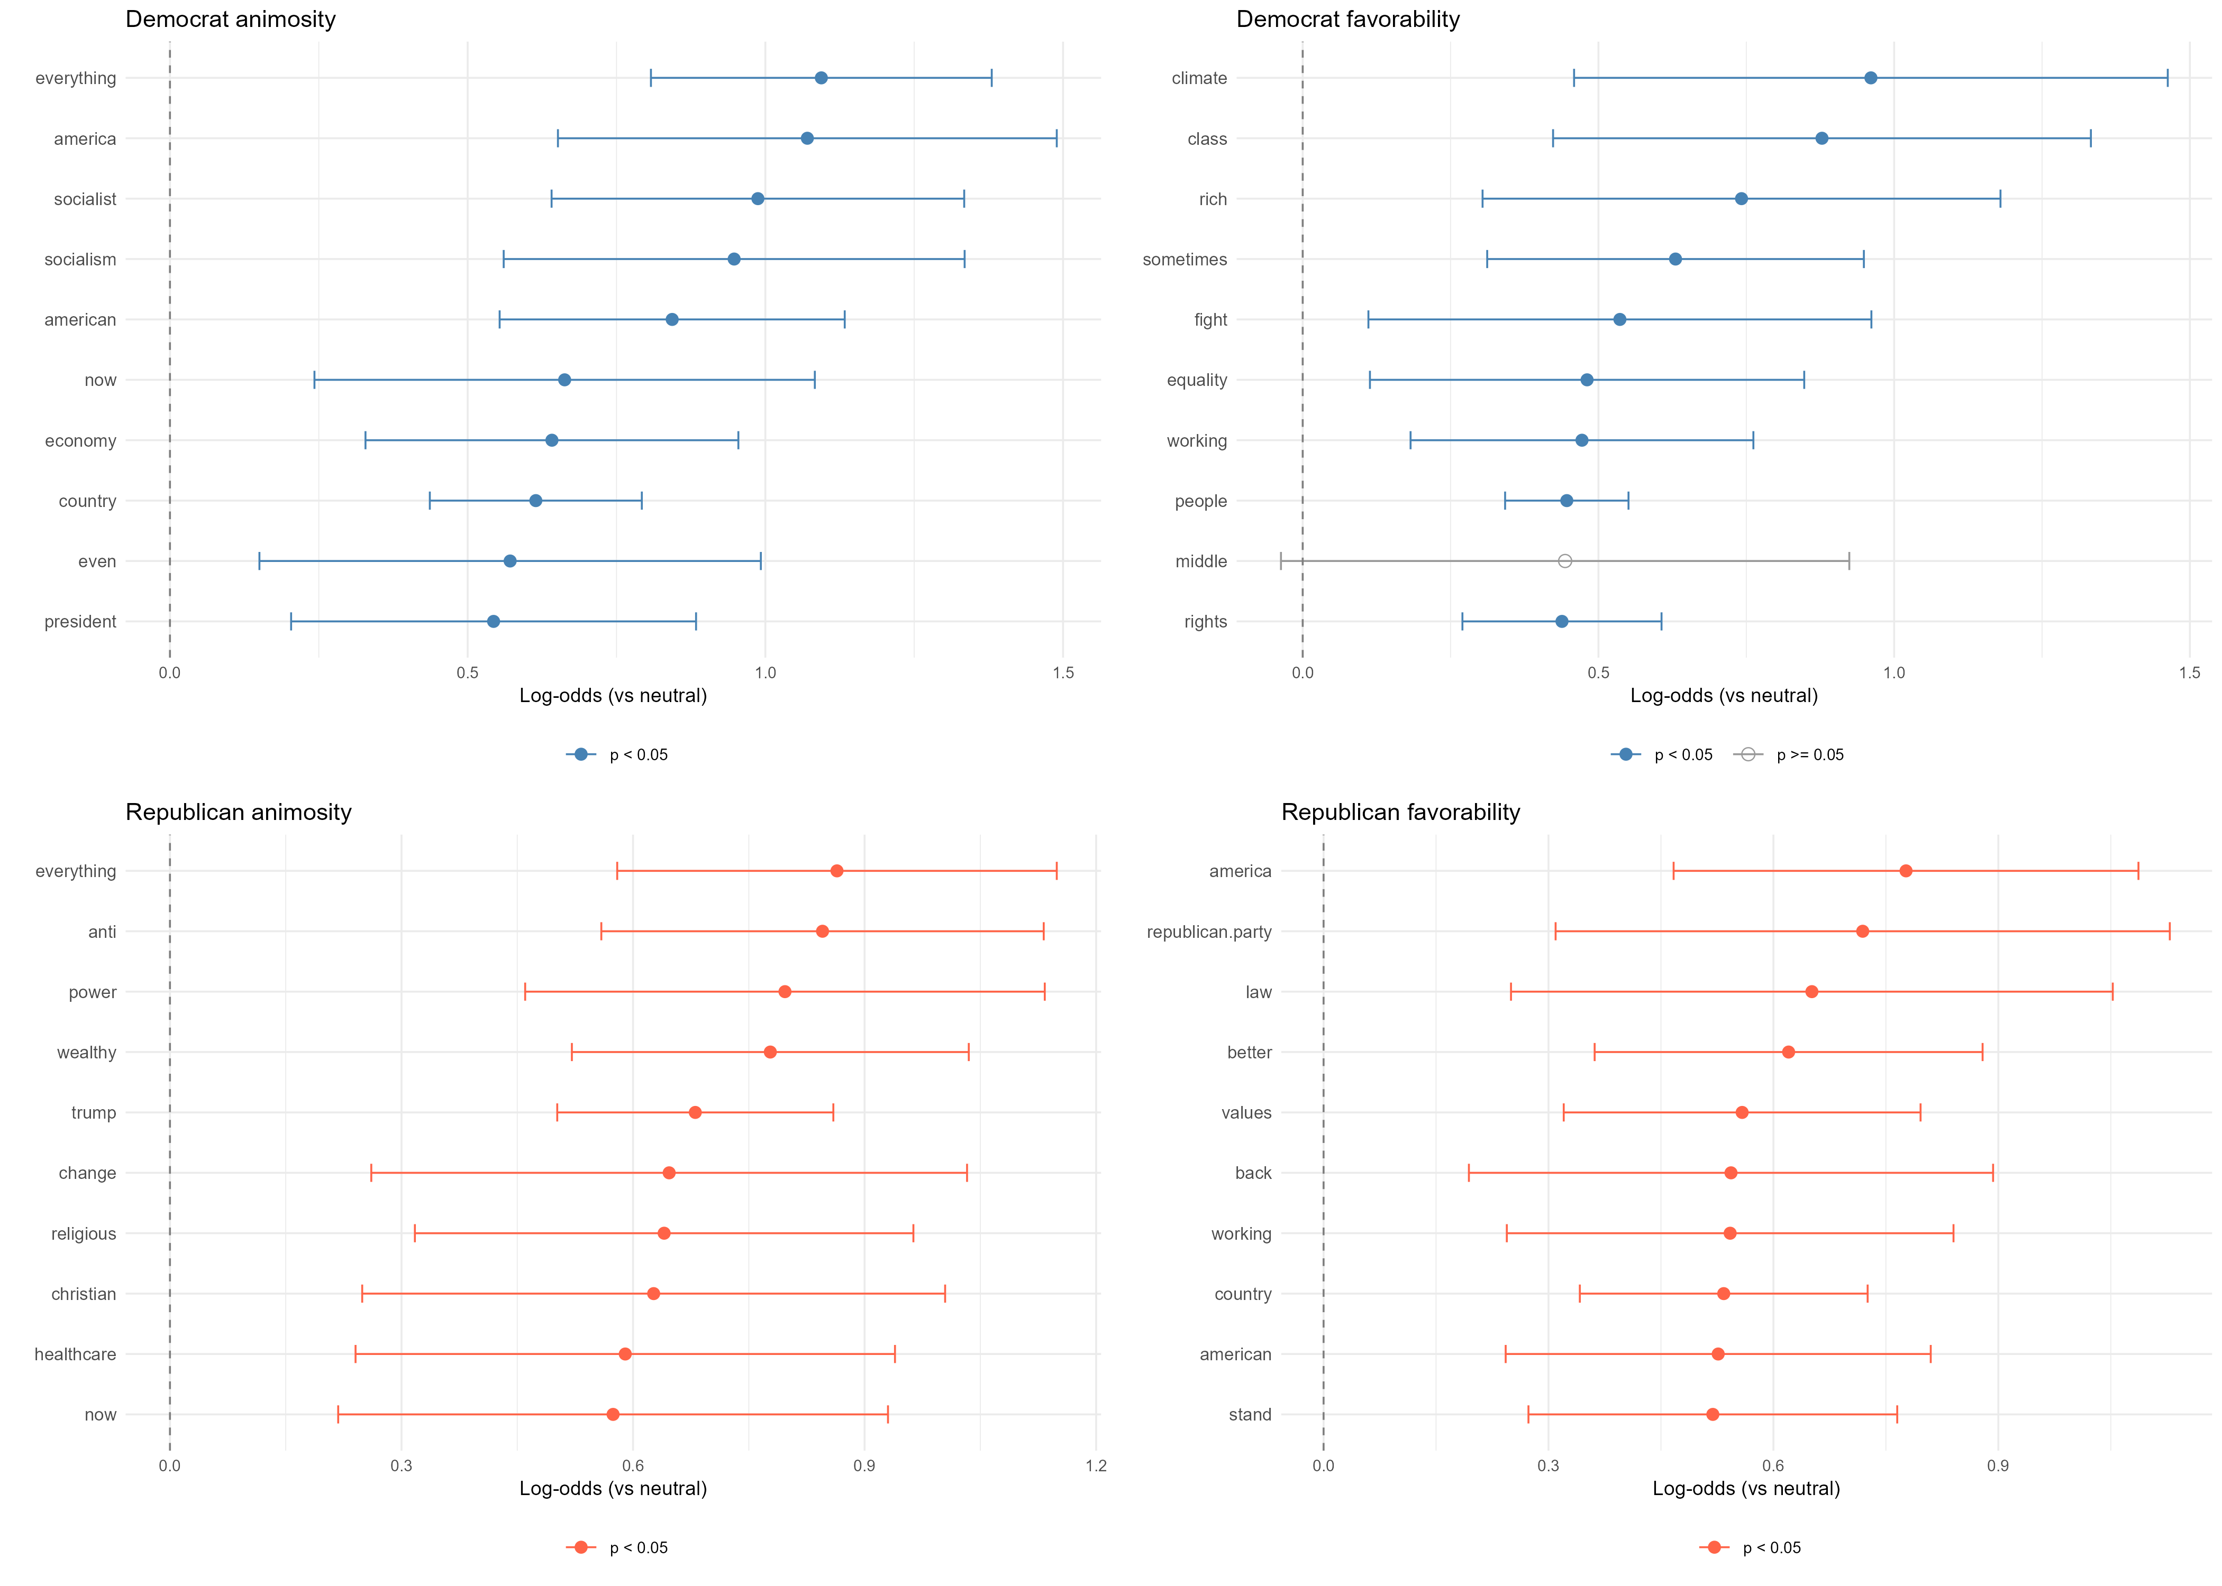
Democrat animosity is linked to ideological traits and immigration / crime policy, and favorability to progressive identity
Top 10 predictors only

Slide 17
Republican animosity is driven by identity and class concerns, with favorability driven by national identity and economic themes
Top 10 predictors only

Slide 18
Study 1: Key Findings
Partisan animosity is rising, driven by distinct mechanisms for each party
Democrat animosity is primarily ideological and policy-driven, with trait labeling (“socialist”) and immigration and crime concerns (“border”, “illegal” “crime”)
Republican animosity skews more affect and identity-based, linked to race (“racist”), economic class (“wealthy”, “corporations”, “big business”) and Trump
Climate is a wedge issue post-2020: it is the strongest single animosity predictor for Republicans and a leading favorability predictor for democrats – however, it drops out of the most frequently appearing terms if 2016 is also included

Slide 19
Agenda
RESEARCH QUESTIONS AND DATA
How can we predict partisan animosity and favorability?
ANES (American National Election Studies) dataset
METHODS
Study 1: Text mining analysis to predict partisan favorability and animosity
Study 2: Who responds to open-ended questions on the parties?
RESULTS
Exploratory Data Analysis
Study 1: Text mining analysis to predict partisan favorability and animosity
Study 2: Who responds to open-ended questions on the parties?

Slide 20
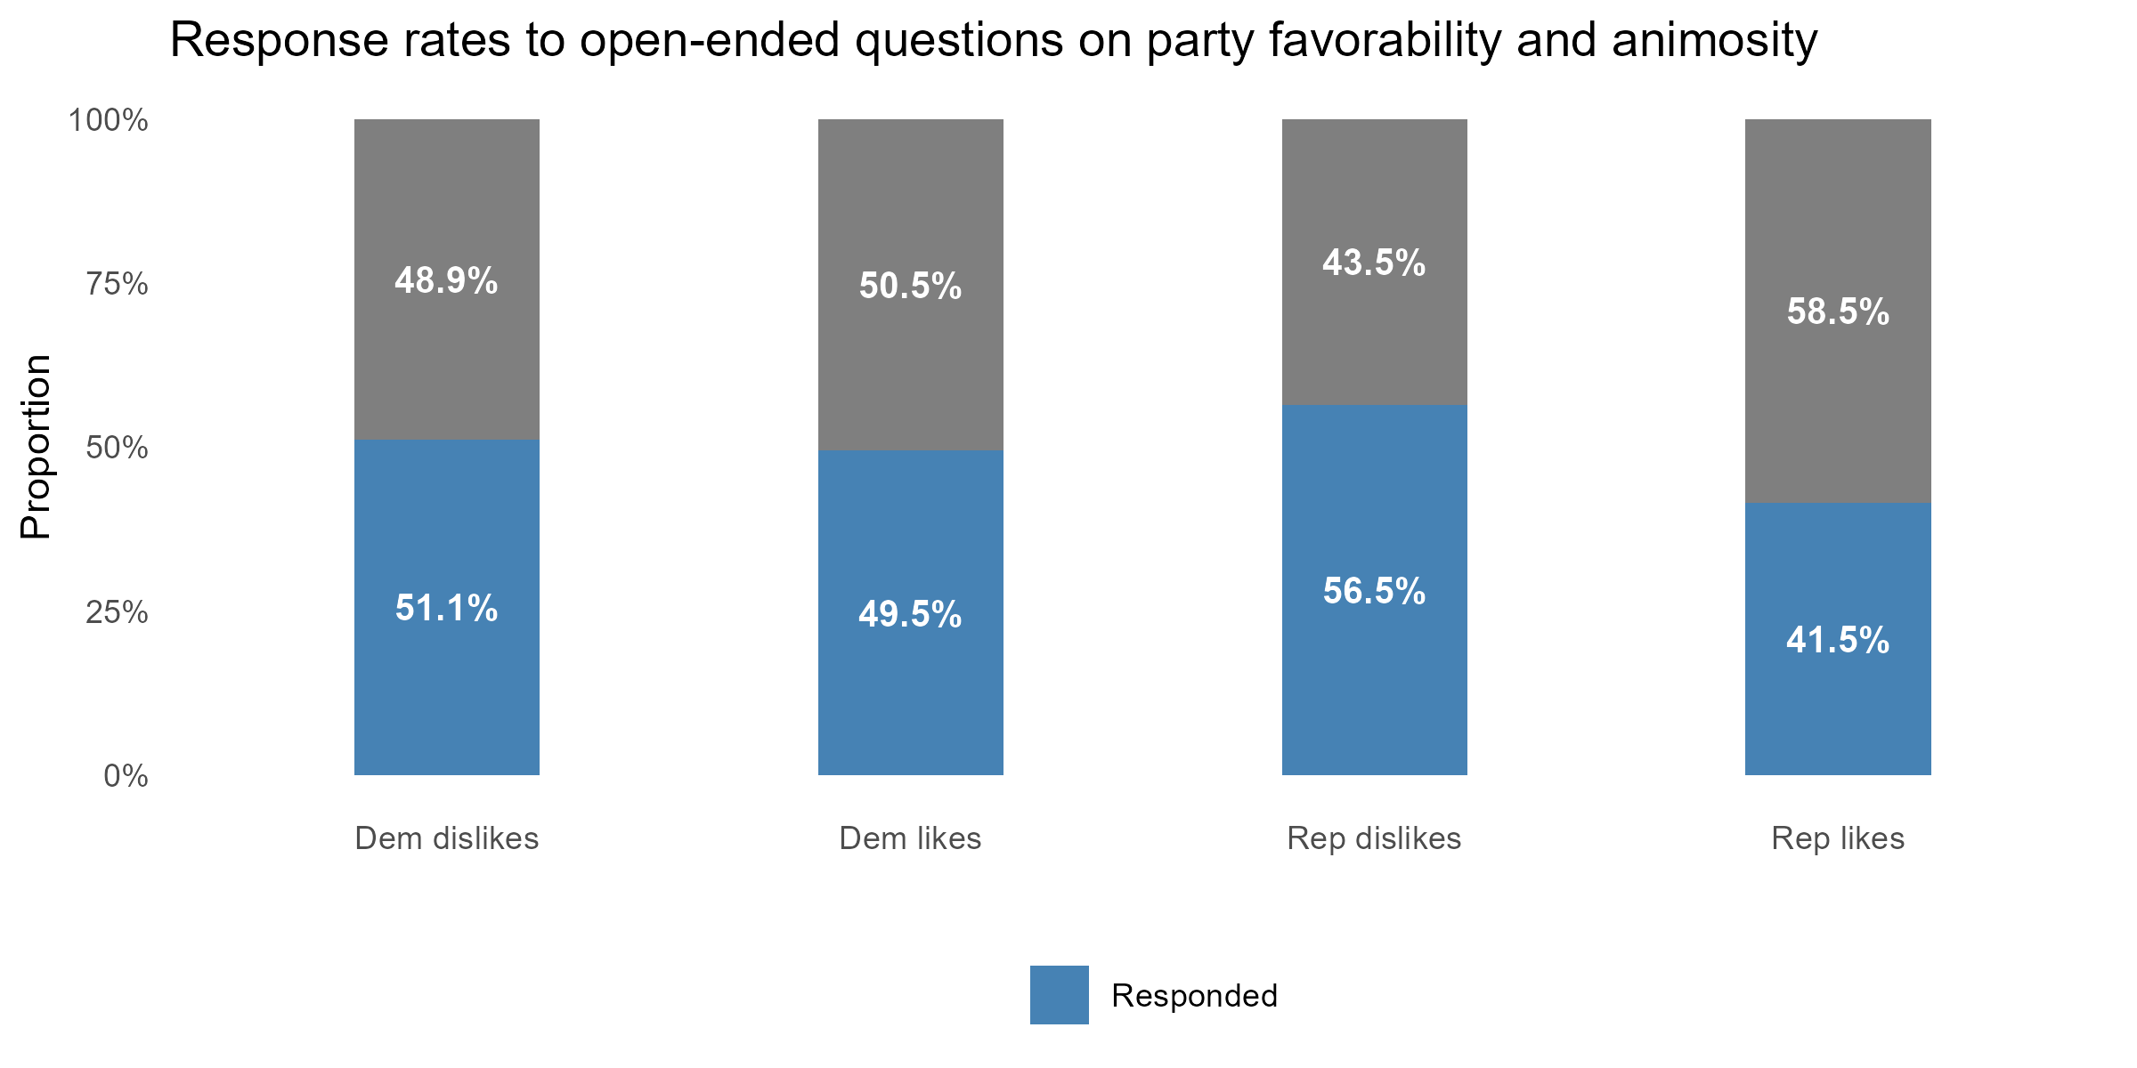
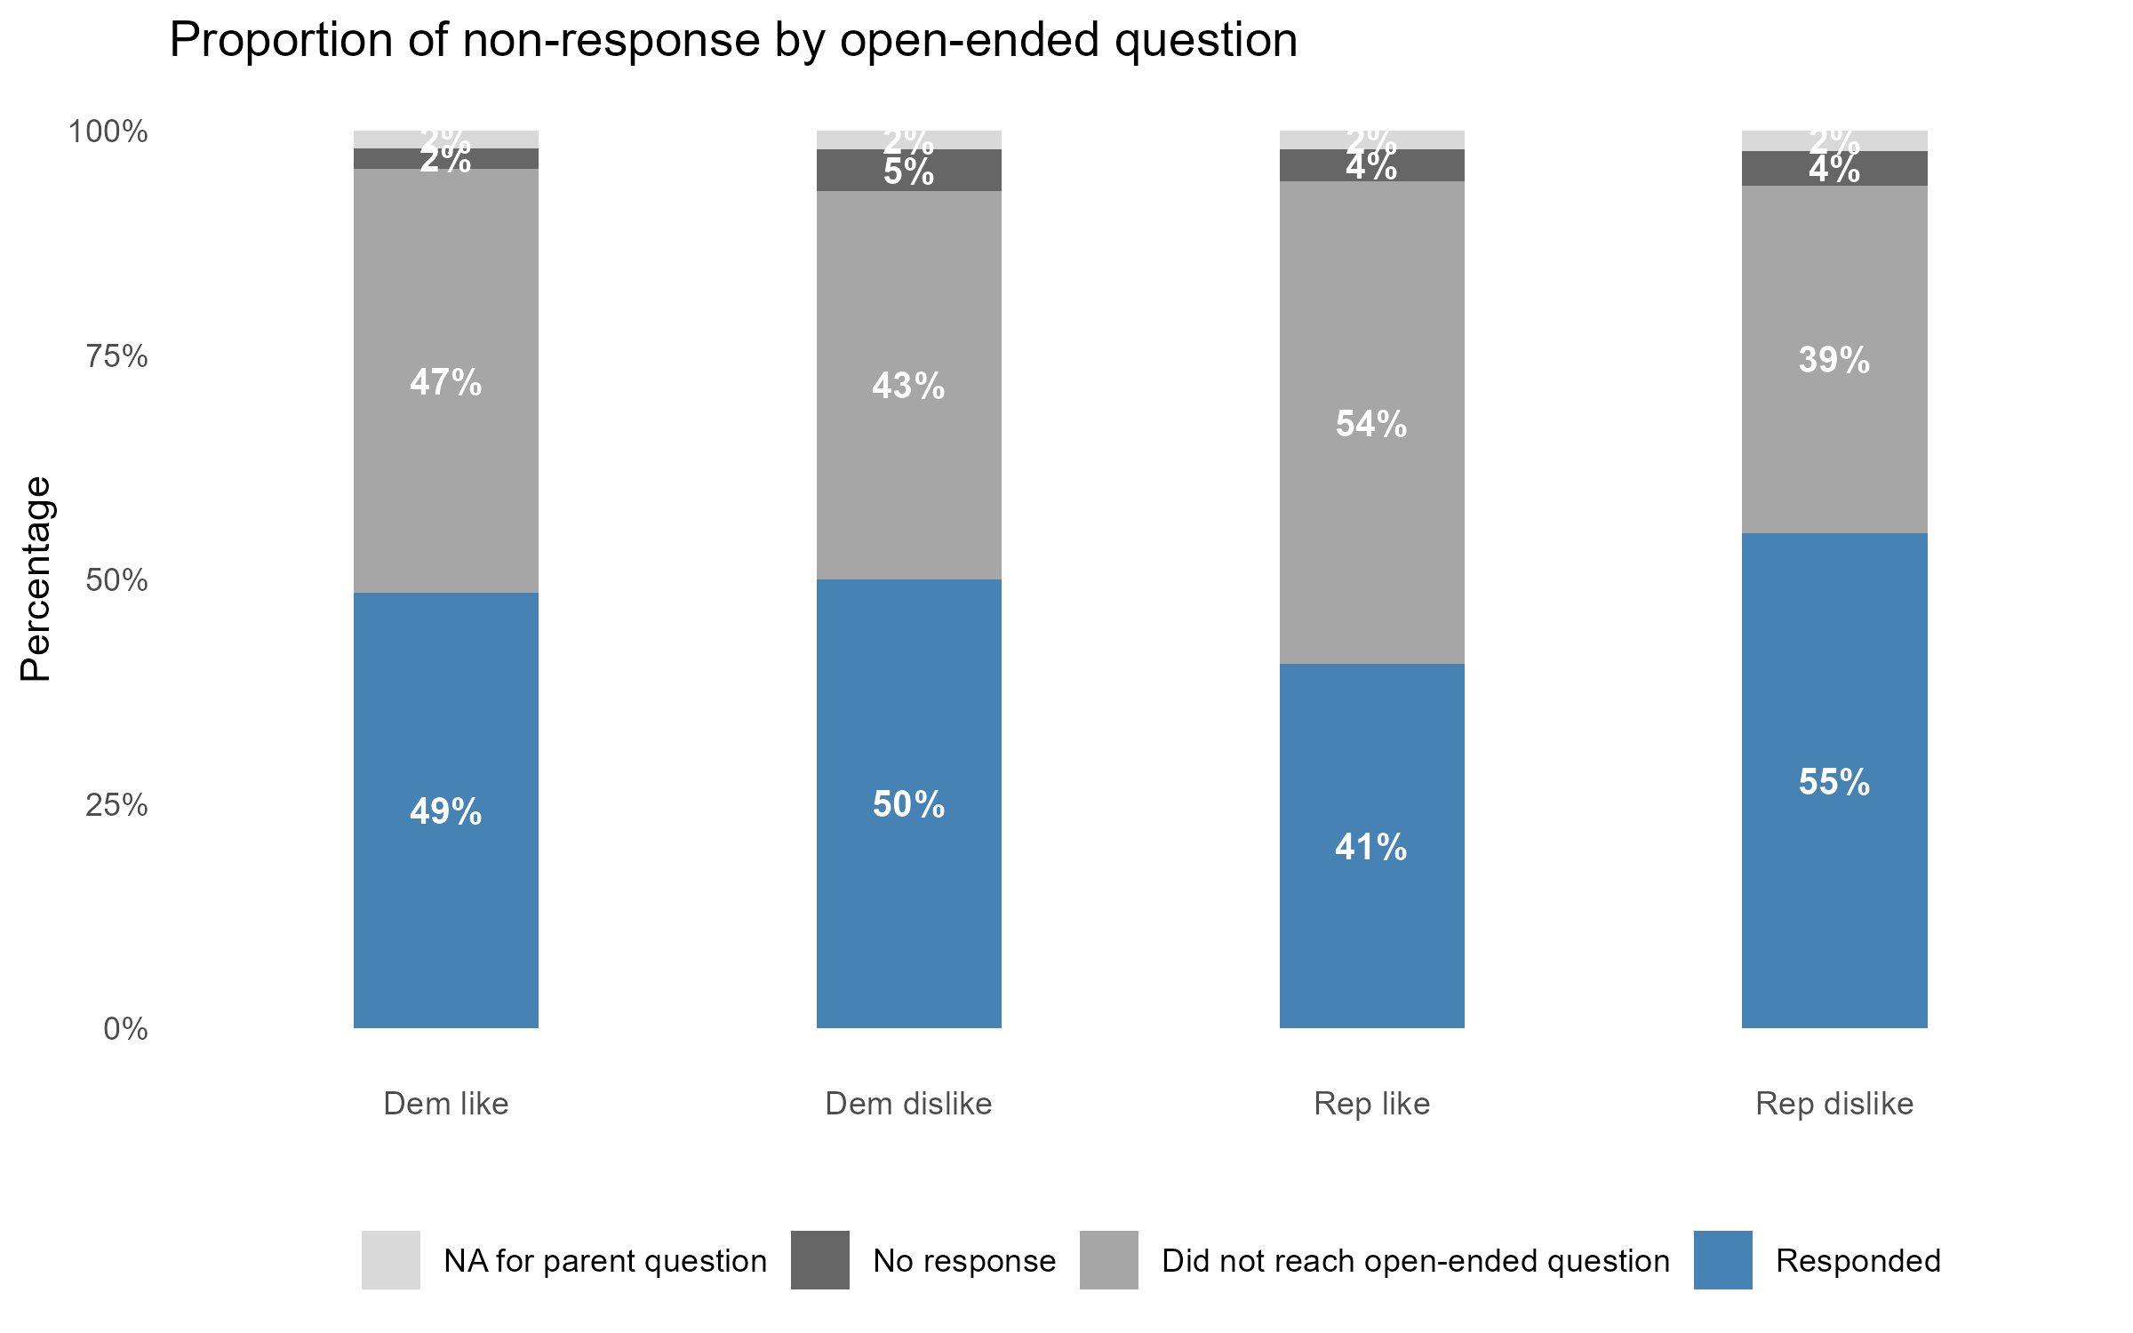
~40-60% of respondents did not provide open-ended text responses

Slide 21
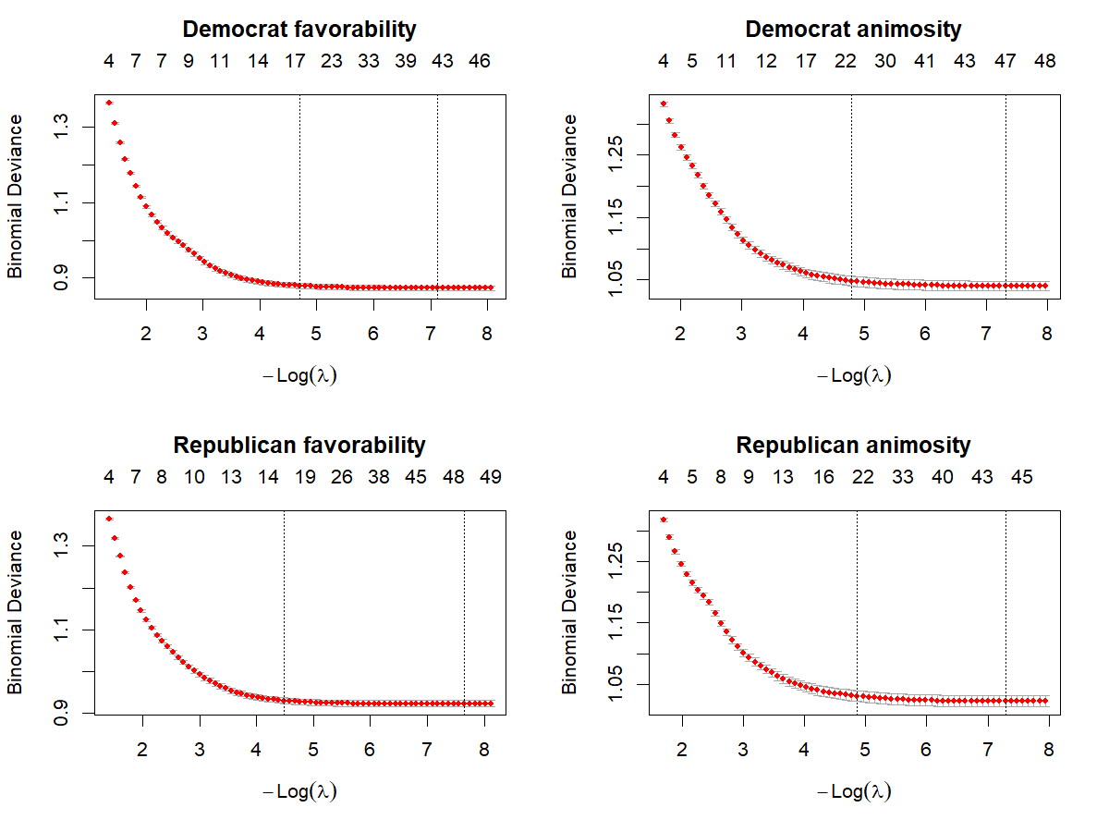
LASSO selects ~15-50 predictors per model (depending on choice of λ)
Use λ.1se-selected terms for relaxed LASSO
(enhanced parsimony)

Slide 22
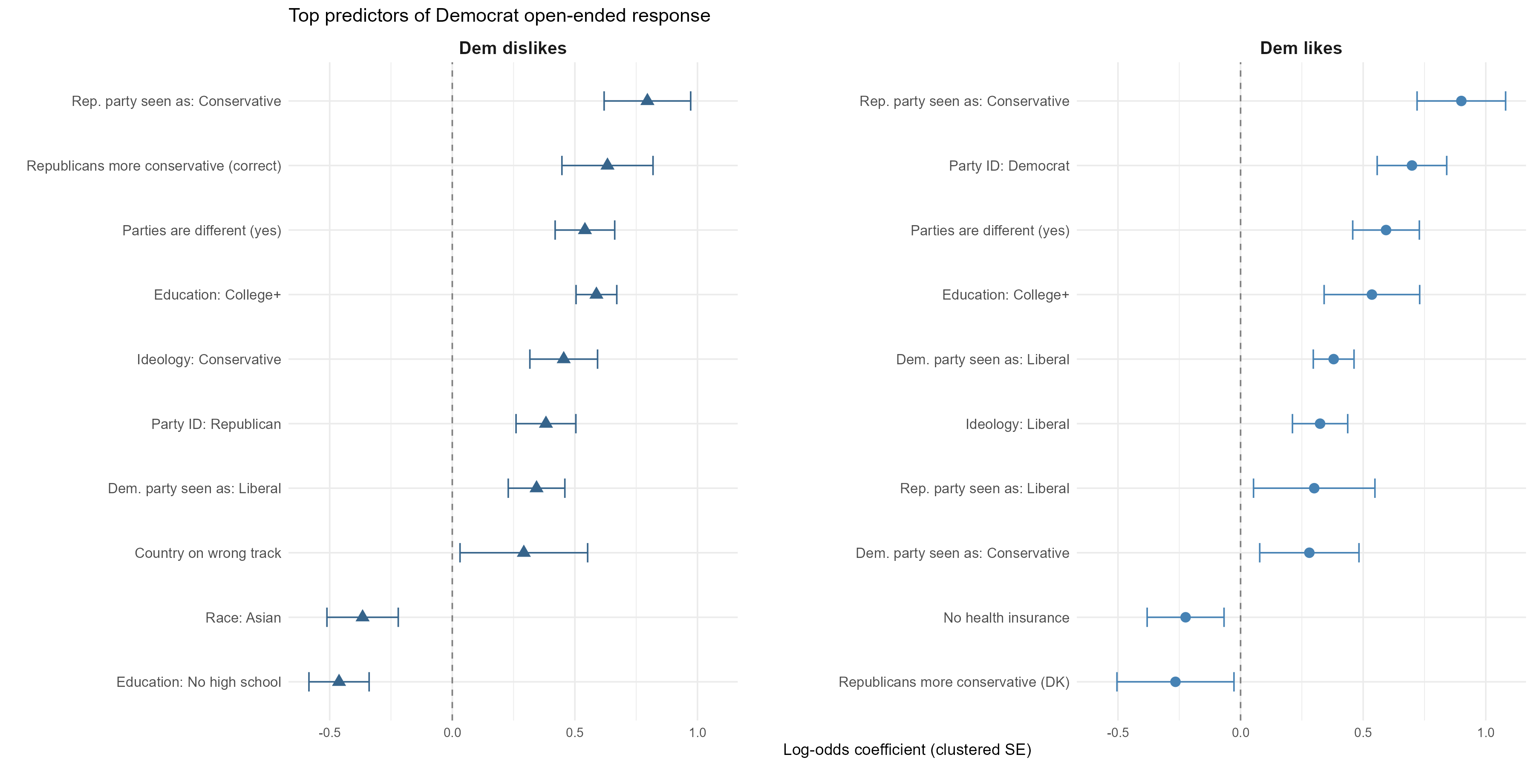
Democrat open-ended responses are driven by partisanship, ideology, and education
Top 10 predictors only

Slide 23
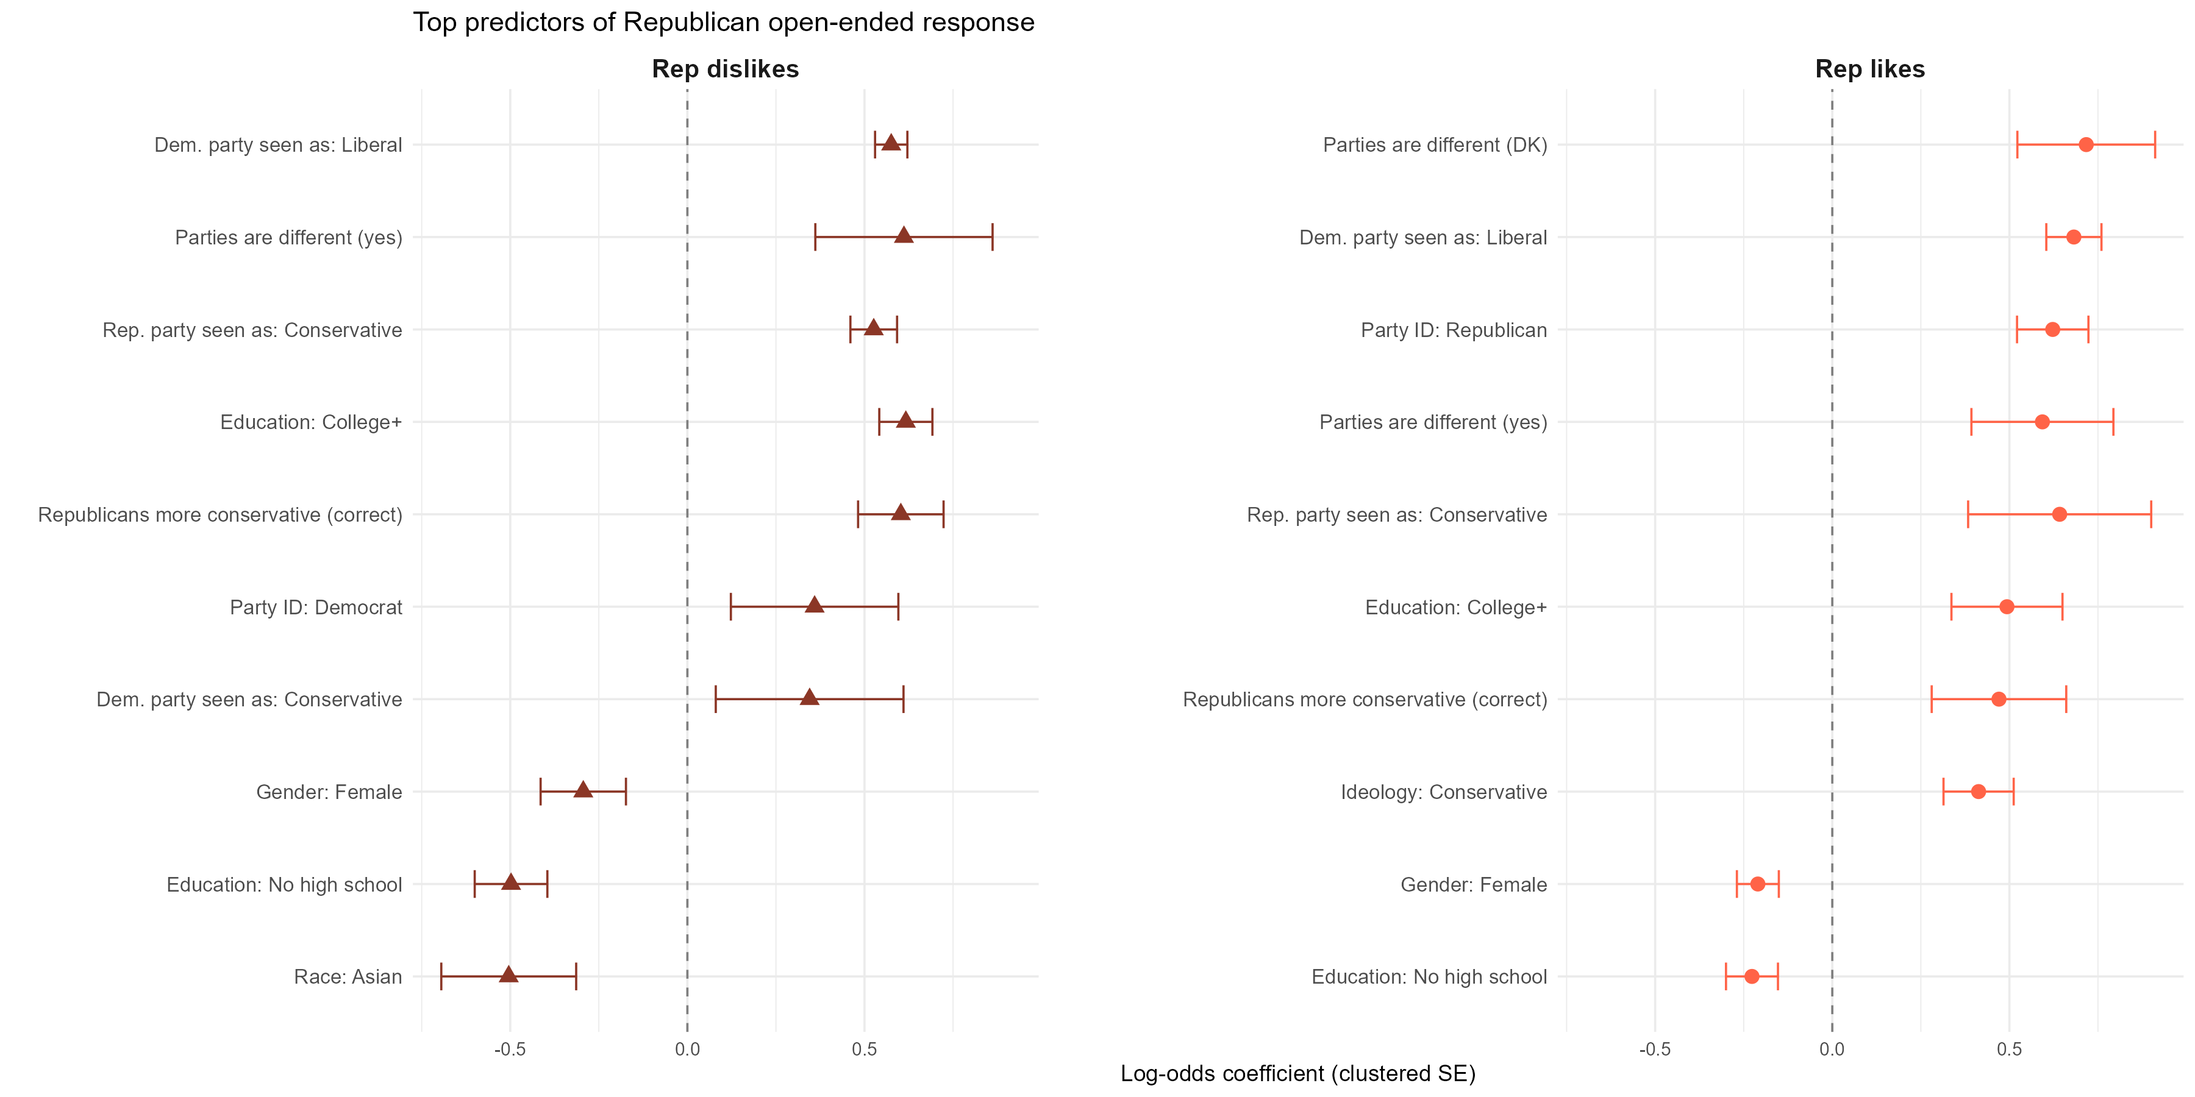
Republican open-ended responses are driven by political engagement
Top 10 predictors only

Slide 24
Study 2: Key Findings
Who respondents to open-ended questions is systematic and nonr-random
Education is the most consistent predictor of response, with college-educated respondents ~60% more likely to respond across all items
Political engagement, measured by perceptions of a difference between the parties, has the single largest effect across models
Partisan strength matters more than direction, with both Democrats and Republicans more likely to respond than independents
Demographics, such as age, gender and race/ethnicity predict responses commenting on animosity more so than favorability
Implications for Study 1: The ~40-60% non-response rate is non-random, motivating a Heckman selection correction for a study extension

